Slide 1


Welcome to the
Capture Academy
It’s an e-commerce course selling web Application
This Project is Directed By :
Debashish Roy
Instructor , Computer Technology
Moulvibazar Polytechnic Institute

Slide 2


Welcome to the
Capture Academy
It’s an e-commerce course selling web application
This Project is presented By :
Mahdee Al Amin
Roll : 476630

Slide 3


Let's Start

Slide 4

What is Capture Academy?
Capture Academy is a summer camp course selling platform, where creativity meets the lens! 📸
Capture Academy is a specialized summer camp dedicated to providing an immersive learning experience in the art of photography. Our platform is designed for enthusiasts of all skill levels, from beginners eager to grasp the fundamentals to seasoned photographers looking to refine their craft.
Capture Academy prioritizes your security with strong authentication and verification processes, guaranteeing a safe and trustworthy environment for all our members. Your journey begins with creating a personalized user profile, allowing you to showcase your personality and interests.
​
​
Basically ensure every students to prepared him to claim many kind of photography courses.
​
​

Slide 5

Features:
Authenticate by Firebase
Claim Your Class
Manage all activities by admin
Online Payment
User Dashboard & Admin Dashboard
Dark Mode.

Slide 6

Used Technology
HTML
MongoDB
CSS(Tailwind)
Context API
JavaScript
JSON web Token
React.js
Firebase
Node.js
Axios.
Express.js

Slide 7
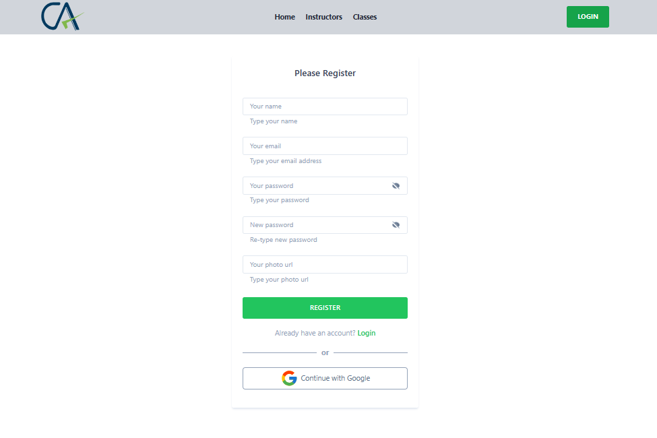
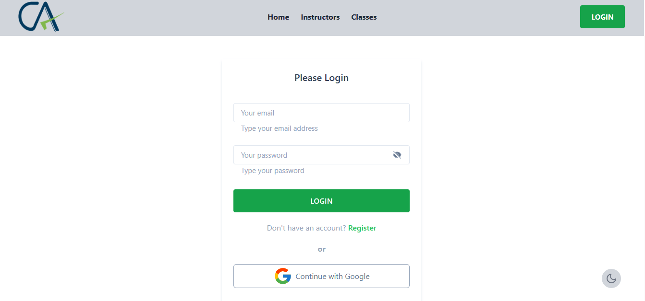
Authentication System
Registration Page
Login Page
User need to provide Firstname ,Lastname , Email , Password , Confirm-Password filed.It's required for registration.If all ok it will send a verification link to user email.
User can login with email & password.
The email must be verified.
if it's verified and password is right.Then user navigate to the news feed

Slide 8
UI Design

Slide 9
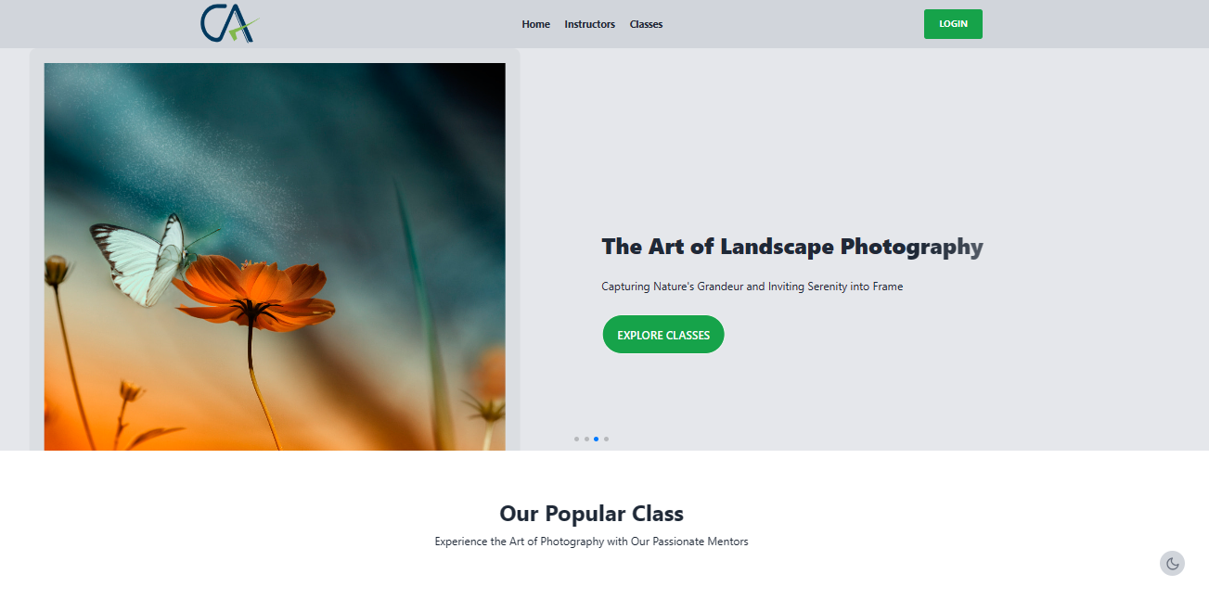
Home Page

Slide 10
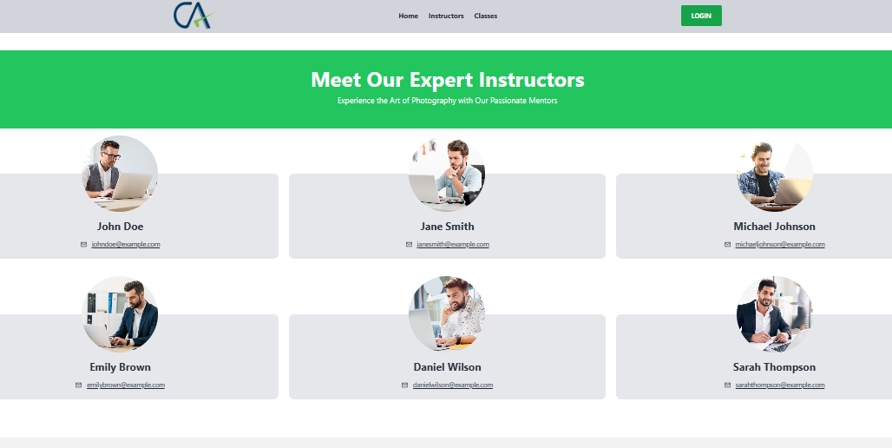
This is Our All Instructor Page where have following information , instructor name , Email.

Slide 11
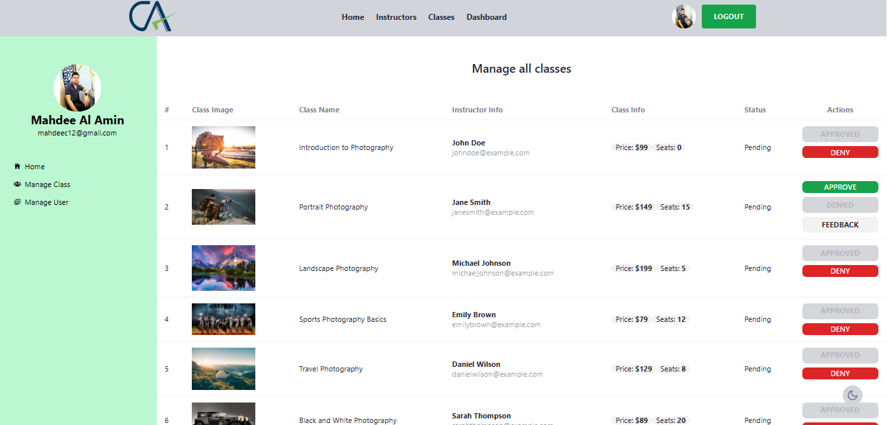
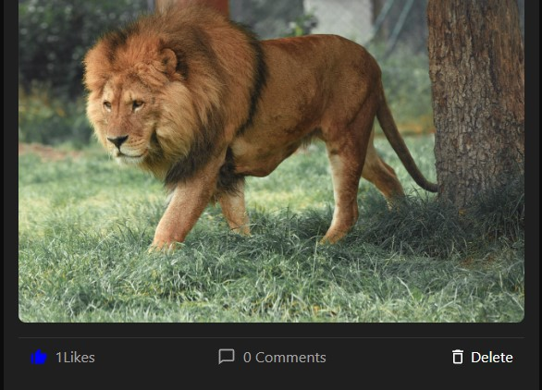
This is admin dashboard layout

Slide 12
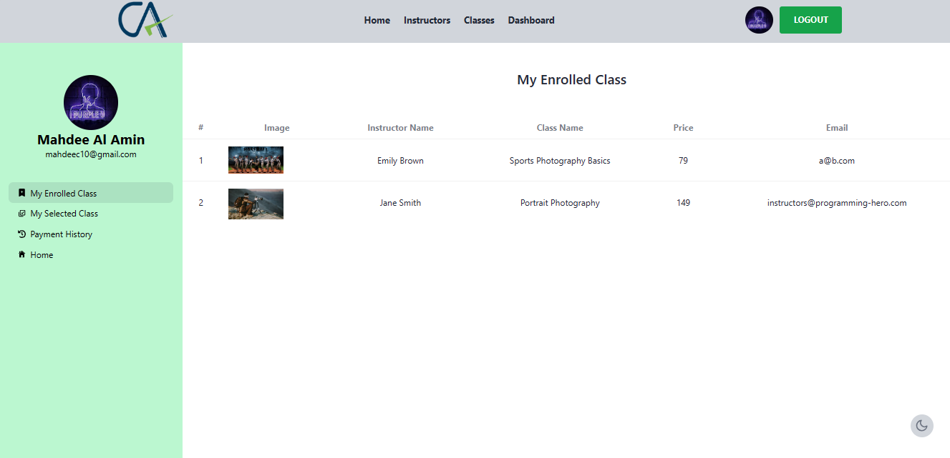
This is User Dashboard Layout

Slide 13
Thanks For Your Time
Capture Academy
DATE

